Slide 1
DevOps Overview
DevOps is a combination of development (Dev) and operations (Ops)
DevOps a set of practices, principles, and tools designed to improve an organization's ability to deliver applications and services faster and more reliably.
In simple terms, DevOps is about:
Breaking down the wall between software development teams (who write code) and operations teams (who deploy and maintain the code).
Automating as much as possible: testing, integration, deployment, monitoring.
Continuously delivering updates, features, and fixes to users faster and more safely.

Slide 2
Key parts of DevOps
CI/CD (Continuous Integration / Continuous Deployment): Automatically building, testing, and deploying code changes.
Automation: Reducing manual work in testing, deployments, infrastructure management, etc.
Monitoring and Logging: Keeping track of software performance and errors in real-time.
Collaboration and Communication: Developers, testers, security, and operations teams working closely together.
Infrastructure as Code (IaC): Managing servers and infrastructure with code (using tools like Terraform, Ansible, etc.).

Slide 3
DevOps
Popular DevOps tools:
CI/CD: Jenkins, GitHub Actions, GitLab CI, Azure DevOps
Containers: Docker, Kubernetes
Monitoring: Prometheus, Grafana
Infrastructure: Terraform, Ansible, AWS CloudFormation

Slide 4
Why DevOps
DevOps helps teams deliver better software, faster and more reliably.
Here are the main reasons organizations adopt DevOps:
1. Faster Time to Market: DevOps enables rapid development, automated testing, and continuous deployment, allowing features and fixes to reach users faster.
2. Improved Quality and Reliability: Automated testing and monitoring ensure fewer bugs and more stable releases. Problems are found and fixed earlier.
3. Continuous Delivery: With CI/CD pipelines, software updates can be delivered frequently and automatically, often multiple times a day.
4. Better Collaboration: DevOps promotes a culture of shared responsibility between developers and operations, breaking down silos and improving communication.

Slide 5
Why DevOps
🔧 5. Automation Reduces Errors: By automating builds, tests, deployments, and infrastructure provisioning, DevOps reduces manual errors and human intervention.
📈 6. Scalability and Flexibility: With practices like Infrastructure as Code and containerization, DevOps helps teams scale applications and infrastructure efficiently.
📊 7. Continuous Feedback and Improvement: Integrated monitoring and logging tools provide insights that help continuously improve application performance and user satisfaction.
💸 8. Cost Savings: Faster development cycles, fewer outages, and efficient infrastructure management often lead to lower operational costs.

Slide 6
Benefits of DevOps
🔄 1. Faster Release Cycles
Automates the software development lifecycle.
Allows rapid delivery of features, bug fixes, and updates.
✅ 2. Improved Quality and Fewer Failures
Continuous integration and automated testing catch issues early.
Frequent small updates reduce risk compared to big releases.
🤝 3. Better Collaboration and Communication
Breaks down silos between development, operations, QA, and other teams.
Encourages a culture of shared responsibility and accountability.
🛠️ 4. Increased Automation and Efficiency
Reduces manual work through CI/CD pipelines, infrastructure as code, and automated testing.
Speeds up development and deployment processes.

Slide 7
Benefits of DevOps
📈 5. Improved Performance and Monitoring
Continuous monitoring tools help identify and fix performance bottlenecks quickly.
Real-time insights into system health and usage.
💪6. Greater Stability and Reliability
Automated rollback, containerization, and consistent environments reduce deployment issues.
Faster recovery from failures.
📦 7. Scalable Infrastructure
Tools like Kubernetes and Terraform help scale applications and infrastructure seamlessly.
Easier to manage complex or cloud-based environments.

Slide 8
Benefits of DevOps
🔒 8. Enhanced Security
DevSecOps integrates security checks into every stage of the pipeline.
Ensures compliance and reduces vulnerabilities early in development.
💰 9. Cost Savings
Less downtime, faster delivery, and automation lead to reduced operational costs over time.
🌟 10. Continuous Improvement
Feedback loops from monitoring and end users help continuously refine the product and process.

Slide 9
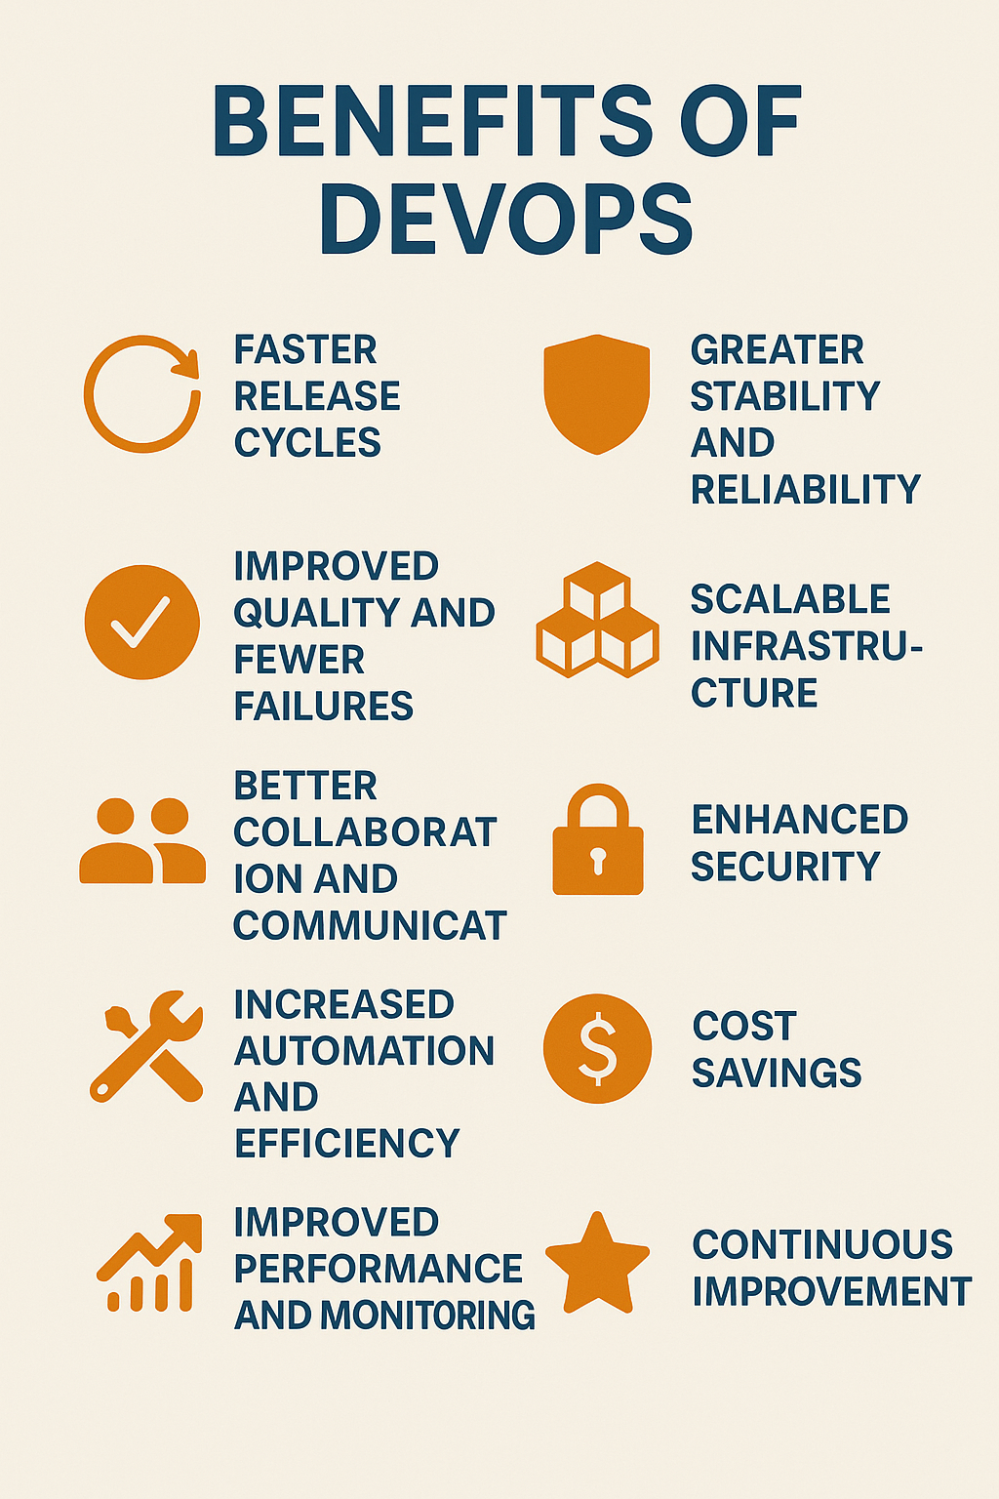
Benefits of DevOps

Slide 10
DevOps Stages
The DevOps lifecycle consists of several key stages that together enable continuous development, integration, testing, deployment, and monitoring of software.
Here’s a breakdown of the typical DevOps stages:
1. Plan
Define project scope, requirements, and tasks.
Tools: Jira, Azure Boards, Trello
2. Develop
Write and manage source code collaboratively.
Use version control systems and code repositories.
Tools: Git, GitHub, GitLab, Bitbucket

Slide 11
DevOps Stages
3. Build
Compile and package code into executable applications.
Includes dependency management and artifact creation.
Tools: Maven, Gradle, Jenkins, Azure DevOps
4. Test
Automatically test the application for bugs, security issues, and performance problems.
Tools: Selenium, JUnit, NUnit, TestNG
5. Release
Prepare for deployment into production.
Ensure approval and compliance processes are followed.
Tools: Jenkins, GitLab CI/CD, Spinnaker

Slide 12
DevOps Stages
6. Deploy
Automatically release applications to target environments.
Can involve blue/green or canary deployments.
Tools: Kubernetes, Docker, Ansible, AWS CodeDeploy
7. Operate
Manage and operate the application in production.
Ensure availability, performance, and reliability.
Tools: Kubernetes, Docker Swarm, Terraform
8. Monitor
Collect and analyze logs, metrics, and feedback from users.
Drive improvements based on real-world data.
Tools: Prometheus, Grafana, ELK Stack, Datadog

Slide 13
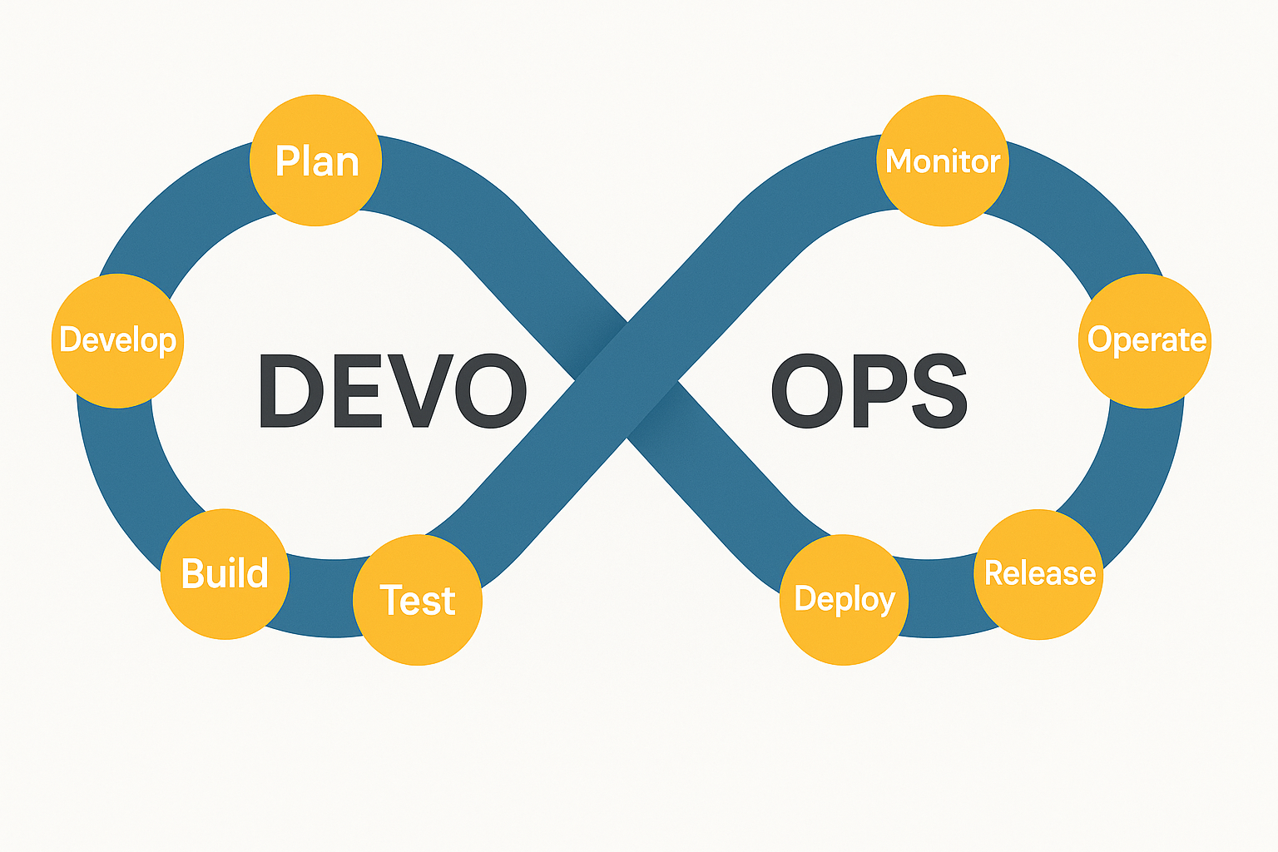
DevOps Stages

Slide 14
DevOps LifeCycle
The DevOps Lifecycle is a continuous process of software development, testing, deployment, and monitoring, all aimed at delivering high-quality software faster and more reliably. It's typically represented as an infinite loop with the following phases
DevOps Lifecycle Stages
1. Plan
Define requirements, user stories, and goals.
Tools: Jira, Azure Boards
2. Develop
Write and manage code using version control
Tools: Git, GitHub, GitLab

Slide 15
DevOps LifeCycle
3. Build
Compile code, run unit tests, and prepare artifacts.
Tools: Maven, Gradle, Jenkins, Azure DevOps
4. Test
Automated and manual testing to ensure quality.
Tools: Selenium, JUnit, NUnit, Postman
5. Release
Approve and package the final build for deployment.
Tools: Jenkins, GitLab CI/CD

Slide 16
DevOps LifeCycle
6. Deploy
Roll out the application to production or staging.
Tools: Kubernetes, Docker, Ansible
7. Operate
Maintain system health and manage infrastructure.
Tools: Terraform,Azure,AWS,GCP
8. Monitor
Collect data, logs, and metrics for performance and issues.
Tools: Prometheus, Grafana, ELK Stack

Slide 17
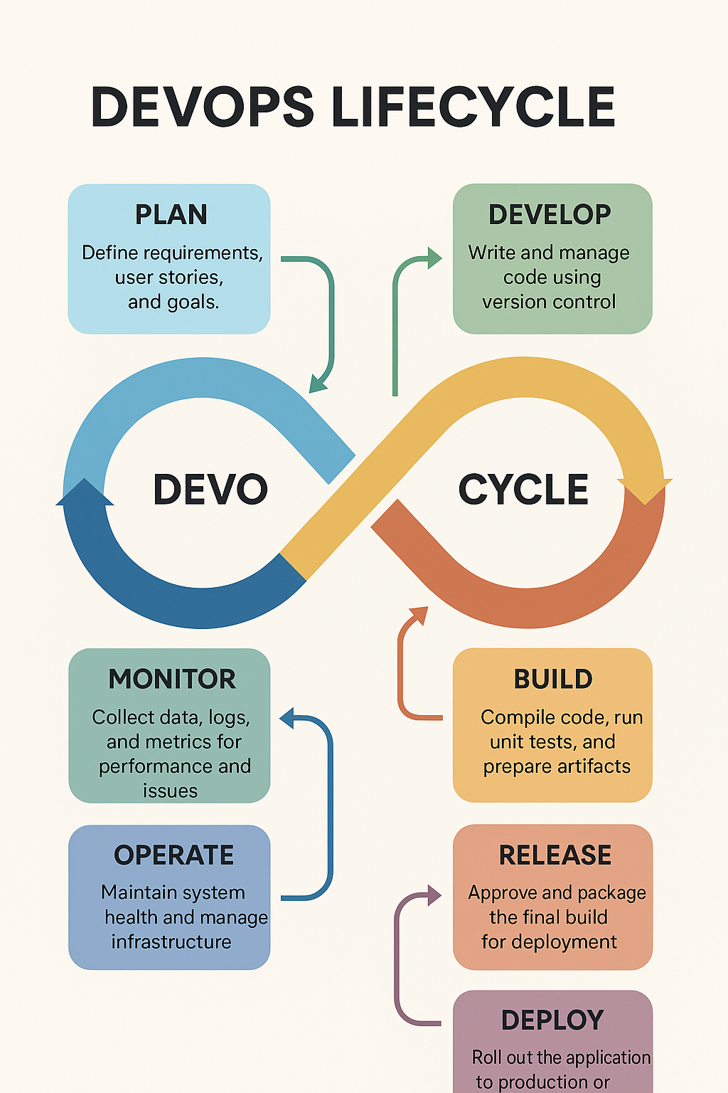
DevOps LifeCycle

Slide 18
Automation in DevOps
Automation in DevOps is key to speeding up software delivery, improving quality, and reducing manual errors.
It spans the entire DevOps lifecycle.
Here's a breakdown of the various automation areas in DevOps:
🔧 1. Infrastructure Automation
Automating provisioning and configuration of servers and cloud resources.
Tools: Terraform, Ansible, AWS CloudFormation, Chef, Puppet
Benefits: Faster environment setup, consistency, and scalability
💻 2. Build Automation
Automates compiling source code, resolving dependencies, and creating artifacts.
Tools: Jenkins, Maven, Gradle, GitLab CI
Benefits: Faster and consistent builds

Slide 19
Automation in DevOps
✅ 3. Test Automation
Automatically runs unit, integration, and regression tests during CI/CD.
Tools: Selenium, JUnit, NUnit, Postman, Cypress
Benefits: Catch bugs early, save time, increase test coverage
🚀 4. Deployment Automation
Automates the release of applications to various environments.
Tools: Jenkins, Spinnaker, Argo CD, Octopus Deploy
Benefits: Faster, safer, and repeatable deployments
5. CI/CD Pipeline Automation
Automates the entire workflow from code commit to deployment.
Tools: GitHub Actions, GitLab CI/CD, Azure DevOps, CircleCI
Benefits: Reduced manual effort, faster feedback loops

Slide 20
Automation in DevOps
🔍 6. Monitoring & Alerting Automation
Automatically collects logs, metrics, and sends alerts on anomalies.
Tools: Prometheus, Grafana, ELK Stack, Datadog, New Relic
Benefits: Immediate detection of issues and reduced downtime
🔐 7. Security Automation (DevSecOps)
Integrates security checks into CI/CD pipelines automatically.
Tools: Snyk, Aqua, SonarQube, OWASP ZAP
Benefits: Early detection of vulnerabilities, improved compliance
📜 8. Documentation Automation
Automatically generates or updates documentation from code or pipelines.
Tools: Swagger/OpenAPI, Doxygen, MkDocs
Benefits: Up-to-date documentation without manual effort

Slide 21
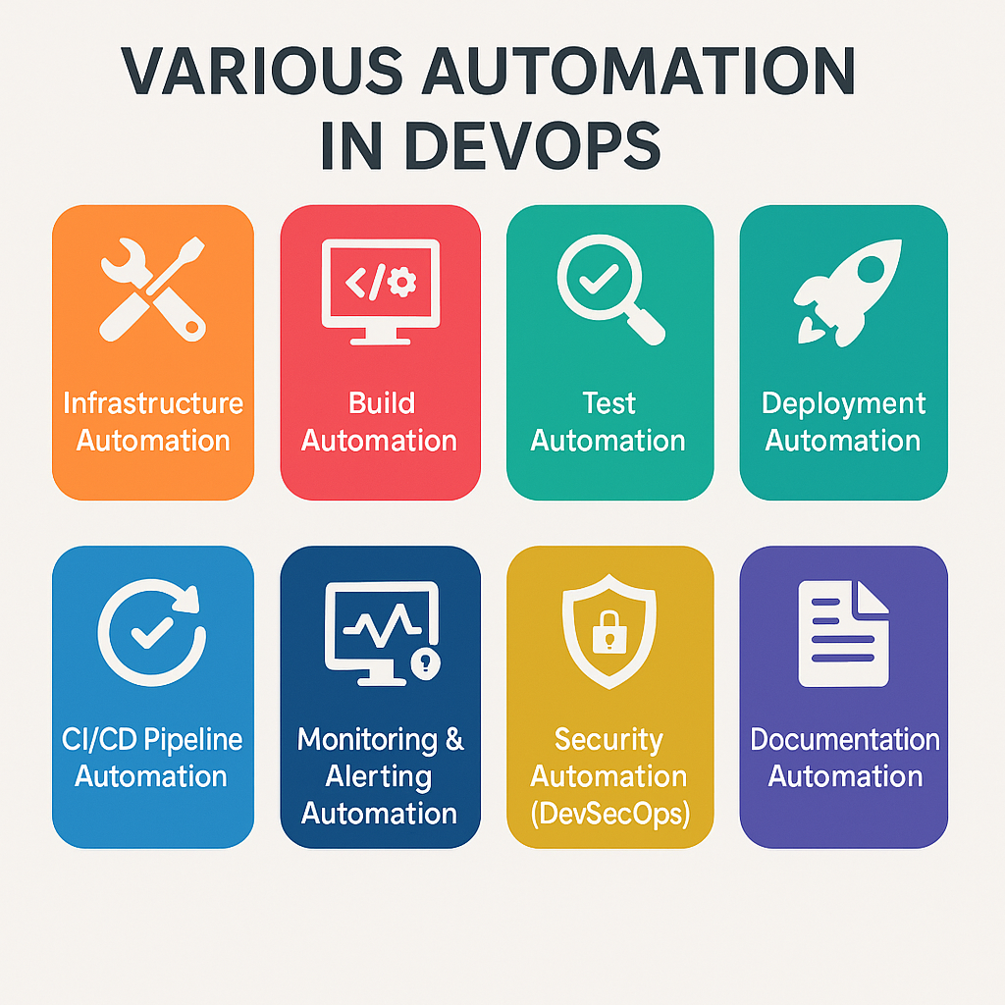
Automation in DevOps

